Slide 1
SECURE DATA HIDING IN IMAGE USING STEGANOGRAPHY
CAPSTONE PROJECT
Presented By: Dheera Ganesh Reddy
Student Name : Thodima Dheera Ganesh Reddy
College Name & Department : Rajeev Gandhi Memorial College of Engineering & Technology. CSE- (Cyber Security)

Slide 2
OUTLINE
Problem Statement
Technology used
Wow factor
End users
Result
Conclusion
Git-hub Link
Future scope

Slide 3
PROBLEM STATEMENT
It focuses on developing a secure data hiding technique using steganography to hide sensitive information within digital images.
The objective is to ensure the hidden data remains imperceptible to the human eye while maintaining the image quality and providing high security against detection and extraction attacks.
The solution should optimize data capacity, security, and resilience against common image processing operations like compression and noise.

Slide 4
TECHNOLOGY USED
We have used libraries called : cv2 os string
Platform to Run the code we used is VSCode (Visual Studio Code).

Slide 5
WOW FACTORS
This project stands out from others due to its focus on enhancing both the security and imperceptibility of hidden data within images using advanced steganography techniques. Unlike basic methods, it aims to improve robustness against modern detection algorithms, image processing attacks (e.g., compression, cropping, noise), and unauthorized extraction.
By integrating encryption before embedding, adaptive embedding strategies, and potentially leveraging machine learning for dynamic hiding patterns, the project ensures higher data capacity, better image quality retention, and stronger security, making it suitable for secure communication and data protection applications.

Slide 6
END USERS
Government Agencies.
Corporate Organizations or Companies.
HealthCare Institutions or Hospitals.
Law Enforcement & Military.
Banks or Financial Institutiond.
General Users.

Slide 7
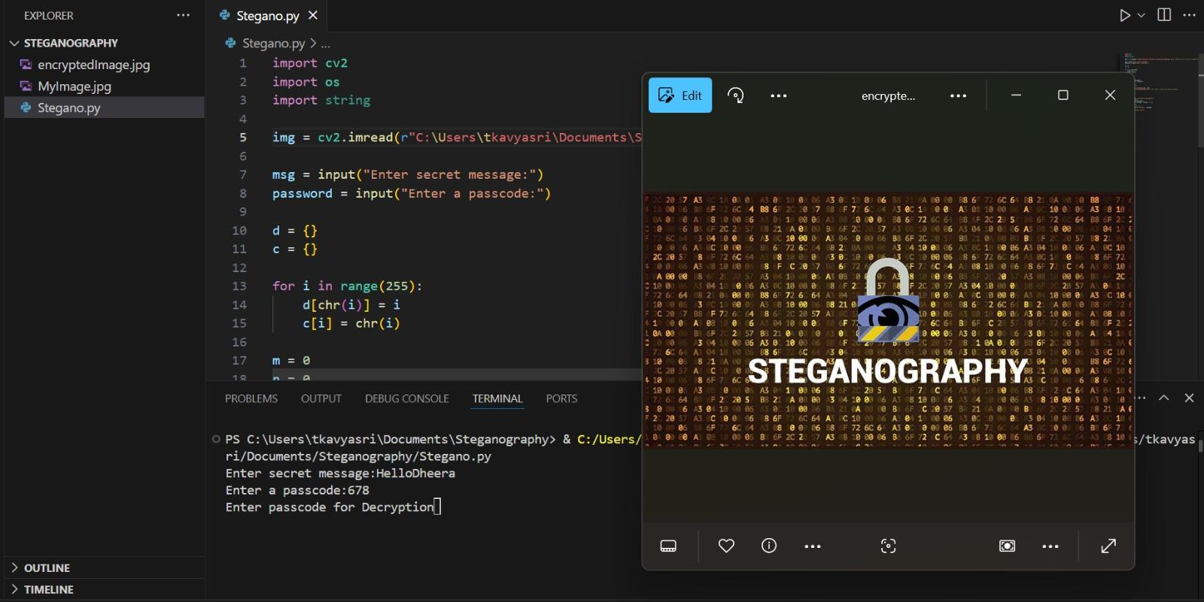
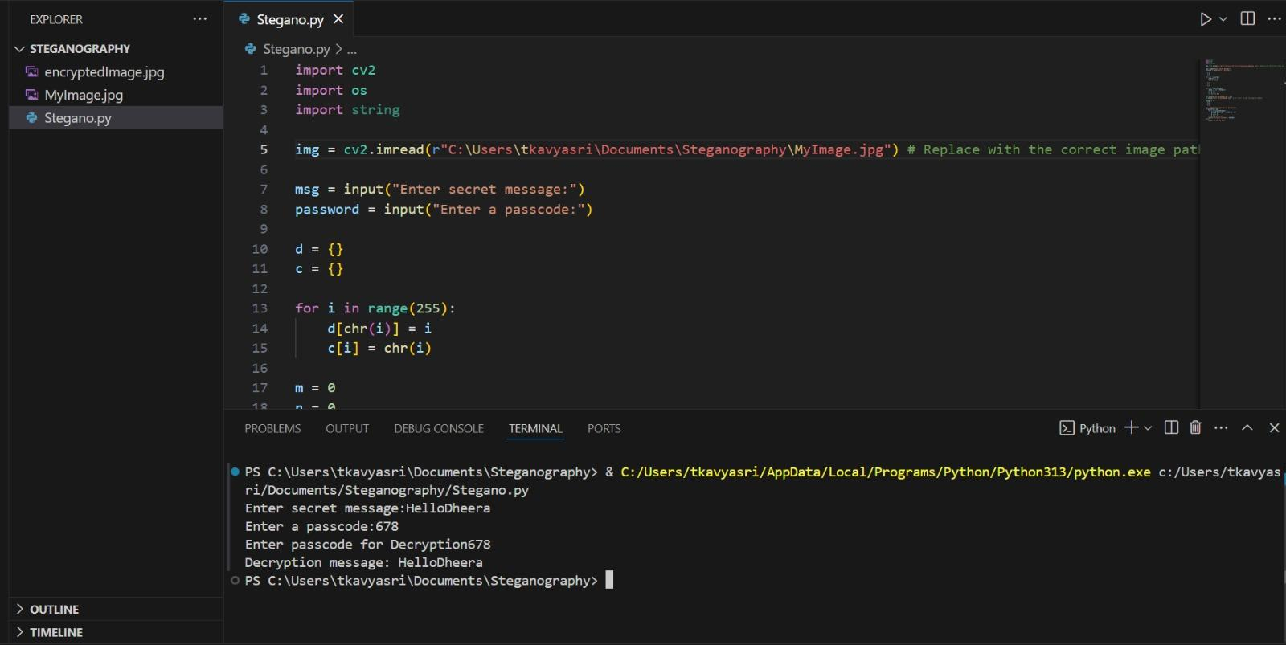
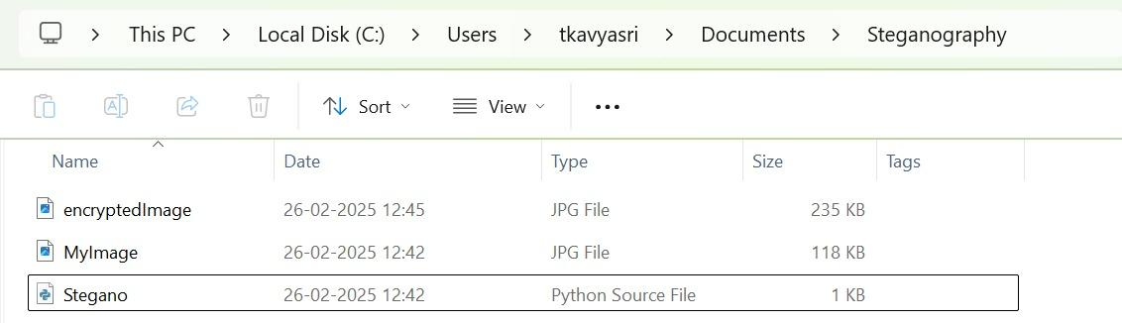
RESULTS

Slide 8
CONCLUSION
The Secure Data Hiding in Images Using Steganography project offers a robust and innovative solution for concealing sensitive information within digital images. By combining advanced steganography techniques with encryption, it ensures high security, imperceptibility, and resilience against common attacks and image manipulations. With applications spanning government, healthcare, corporate, and personal use, the system addresses the growing need for secure data communication and storage. Its adaptability, user-friendly design, and real-time processing capabilities make it a valuable tool in safeguarding digital information in today’s security-conscious world.

Slide 9
GITHUB LINK
https://github.com/DheeraGanesh/AICTE_Stegno_Project

Slide 10
FUTURE SCOPE(OPTIONAL)
Integration with AI & Deep Learning.
Support for Multiple media types.
Cloud based Secure Communication Systems.

Slide 11
THANK YOU

